Slide 1
Database Design Process
C393: Database Systems

Slide 2
WPR Review

Slide 3
Lesson Objectives
Create problem statements to outline a business’s priorities
Document use cases to model users’ interactions with the system

Slide 4
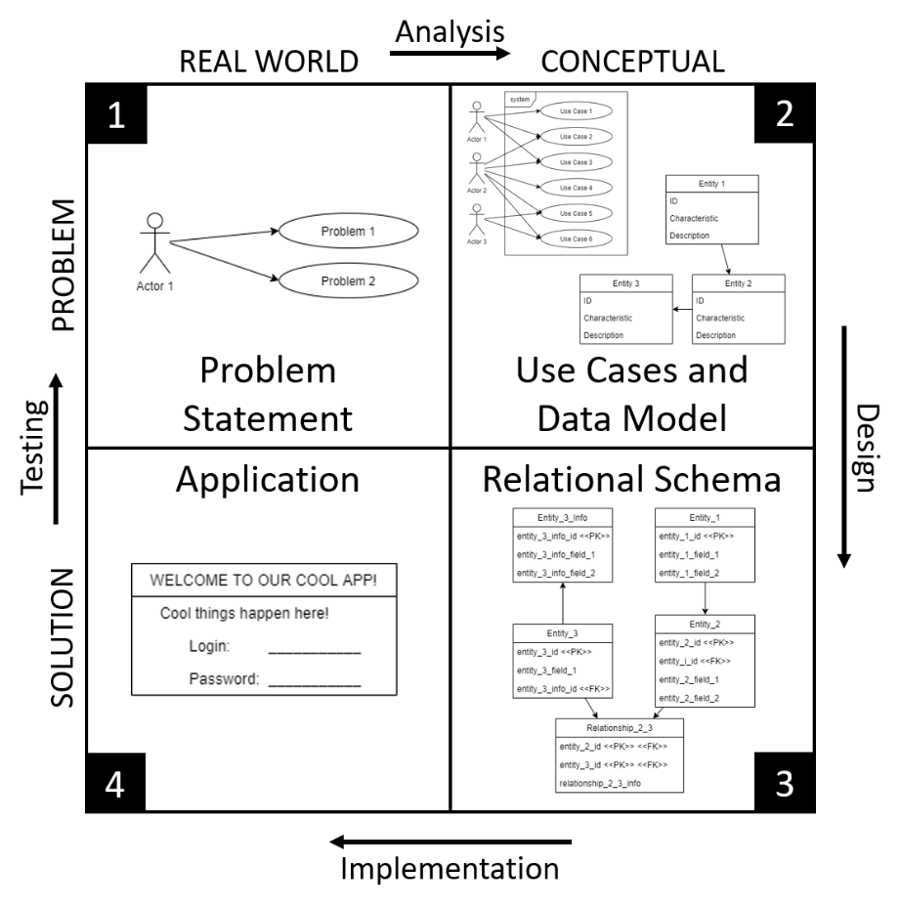
Iterative Design Process
Real World Problem
Problem Statement
Abstract Problem
Use Cases
Data Model
Conceptual Solution
Relational Schema
Interface Design
Implemented Solution
Database
User Interface
Adapted from Zelkowitz et al. 1979
Notes:
What is the point of CS393?
- Teach you to think (like a scientist/engineer)
- Iterative design process
Why do we need a design process? – where else have you used a process?
- It works (tested way to cover all the usual issues)
- Do it right or do it twice / measure twice, cut once / if you don't have time to do it right, when will you have time to do it over?
- Builds documentation for future work
How does this match other design processes you've worked with?
- Situation -> Analysis -> Solution Design -> Solution Implementation -> Test
First we want to understand what is the problem we are trying to solve; we may have a customer we are working with
Objective – what is the goal of this system we are trying to build?
Situation – what does this thing need to do? What are we trying to model?
Use Cases – who are the actors using this system and what do they need the system to do?
Data Model – abstract model of the entities and relationships described in the problem statement
Relational Schema – we take the data model and refine it define a relational database: data types, referential integrity, required/optional attributes
Application: schema implemented using a database management system and then incorporated into a LAMP server
Today we will focus on the Problem Statement
Note that the length of the arrows on the diagram has *nothing* to do with relative weight of each step (analysis, design, implementation, and testing).
They're just however long they fit.

Slide 5
Problem Statement

Slide 6
Trains Database
Objective
Develop an information system for dispatchers to use in managing all aspects of rail operations.
Situation
Trains have cars
Engines or cargo (multiple types)
Trains have crew
Trains go from here to there
Dispatchers input train schedule to system
...
Where do the Objective and Situation come from?
Notes:
The reading talked about a Mission Statement/Objectives and Users’ Requirements/Systems Specification. In CS393, we will call it Objective and Situation respectively (which together form the Problem Statement)
Later in the course we will use the Cartoon Equipment database when we are learning Structured Query Language (SQL). Think Wiley E. Coyote ordering an anvil from the ACME corporation. This database does not just materialize out of thin air. Maybe a designer worked with the ACME corporation to build it. This started with generating a problem statement which consists of an Objective and a Situation (BUILD SLIDE)
Objective and Situation come from a discussion with the customer (customer does not provide it; must be discerned)
It arises from a conversation between the end user or business owner and the development team.
While shThe problem statement should answer many basic questions about the system to be designed.
own as bullets on this slide, we write the Situation in paragraph form.
What do we need to capture in these paragraphs?
What data will be stored? (customers, products, orders, etc) – What are we trying to model?
How is this data categorized in the real world? (build a logical model of a physical world) how would you describe a SSN?
Who will create this data?
Who will use this data? (in both cases we are getting into the actors associated with the data)

Slide 7
Cartoon Equipment
Objective
Develop an information system supporting equipment sales from a catalog.
Situation
Catalog contains products for sale
Products have name, price, and description
Sales manager enters products into catalog
Sales manager maintains list of wholesale vendors
...

Slide 8
Ike Hall Database
Objective
The Director of Theater Operations (DTO) at Eisenhower Hall (Ike Hall) needs an information system to help manage theater operations and personnel.
Situation
A Season has Performances
There are two types of Performances
Professional and Cadet-led
Each type of Performance has attributes
Cadets have attributes
...
Notes:
This is from Homework 1. Concerned with creating an information system to support Ike Hall Theater Operations
If you doing this, what kind of questions would you ask the customer?
What is the Ike Hall Theater?
What is a Performance?
Who participates in a Performance?
When do Performances occur?
What data will be stored?
How is this data categorized in the real world?
Who will create this data?
Who will use this data?

Slide 9
Problem Statement Questions
Why develop a new system?
What issue are users facing?
What other options exist?
Who is the system for?
Who will use it?
Who will manage it?
How will the system be used?
How will data be accessed?
How will data be managed?
When will it be used?
How often will it need to be accessed?
Under what conditions is it useful?
Where will it be used?
Where are the users?
Where is the data (physically) stored?
How do you connect the two?
What information will it hold?
What types of entities will the information represent?
What characteristics of the entities need to be captured?
What relationships exists between different entities?
Will data ever be changed?
Will data ever be deleted?
Notes:
These are all good questions in developing the Problem Statement. In most assignments we will provide you the Problem Statement. However in Homework 3 and the Final Project you will develop the Problem Statement. (and this Lesson Quiz)
Why develop a new system?
Why is this question important
Might help figure out something already exists
Helps to generate requirements
Who is the system for?
Determine who the actors are
Actors could be a customer, an admin, someone who enters data
How, When, Where
All good questions for developing application, determining security requirements
How does an actor access the system?
24/7 availability?
Does multiple people need to access the system at once?
Does the user need physical or remote access?
What information will it hold?
These questions get to the meat of logically representing the physical world in a data model
An entity is a thing:
CIS: a cadet; a course
Cartoon equipment: a customer; a product; an order
Ike Hall: a cadet, a civilian, a performance
Trains: a train, a car, a track, a schedule
Characteristics:
We looked at characteristics of Owners and Pets in the last lesson. What were some of those characteristics?
What are characteristics of Cadets and Courses?
Relationships:
How are entities related
What is the relationship between an Owner and a Pet?
What is the relationship between Cadets and Courses?
Discuss:
What data will be stored?
How is this data categorized in the real world?
Who will create this data?
Who will use this data?

Slide 10
Customer Conversation
Developer cannot create problem statement alone
Requires input from customer / product owner
Developer needs to ask good questions
Problem statement is the foundation for the iterative process
Adapted from Zelkowitz et al. 1979
Notes:
The developer needs customer input
The developer needs to get the customer to describe the problem
This requires good questions
Ultimately the problem statement is the foundation; messing this up can lead to an information system that does not do what the customer needs it to do

Slide 11
Problem Statement Exercise
Take the given scenario
Write a problem statement
Write the situation

Slide 12
Use Cases

Slide 13
Use Case Terms
A Use Case is an action that accomplishes a task within the system
An Actor is someone or something that interacts with the system; actors are external to the system
Actors include both humans and external systems
A Relationship is an interaction between an Actor and a Use Case
Association Relationship is a normal interaction between Actor and Use Case
Include Relationship is an interaction with a Use Case that an Actor does not initiate, but always occurs after a normal interaction with another Use Case
Extend Relationship is an interaction with a Use Case that an Actor does not initiate, but sometimes occurs after a normal interaction with another Use Case
Generalization Relationship is an interaction with a Use Case that is more specialized than another Use Case
Notes:
Systems, Actors, Uses Cases, Relationships
System – Streaming Service Application/Website
Actors – Someone or something that uses the Streaming Service Application/Website
Use Case – Represents an action that accomplishes some sort of task within the Streaming Service Application Website
Relationships – Interaction between an actor and a Use Case
Normal interaction is called an Association Relationship (solid line) – nearly all/if not all of our relationships will be Associations Relationships
Use Case that an Actor does not initiate, but always happens after a Base Use Case is called an Include Relationship (dashed line pointing to included Use Case)
Use Case that an Actor does not initiate, but sometimes happens after a Base Use Case is called an Extend Relationship (dashed line pointing to Base Use Case)
Use Case that is a more specific version of a Base Use Case are called General Use Cases (child of Base Use Case). (solid line with arrow pointing towards Base Use Case)

Slide 14
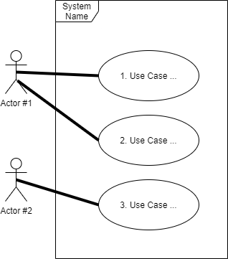
Use Case Diagram
A Use Case Diagram visually depicts how actors interact with the system
A System is represented by a boundary box; actors on the outside and use cases on the inside
Actors are represented by stick figures
Use Cases are represented by ovals
Relationships are represented by lines
Association: solid line from actor to use case
Include: dashed line pointing from base use case to included use case
Extend: dashed line pointing from extended use case to base use case
Generalization: solid line pointing from special use case to base use case
Notes:
Numbering the use cases is helpful for when we write Use Case Paragraphs later on
Normal interaction is called an Association Relationship (solid line) – nearly all/if not all of our relationships will be Associations Relationships
Use Case that an Actor does not initiate, but always happens after a Base Use Case is called an Include Relationship (dashed line pointing to included Use Case)
Use Case that an Actor does not initiate, but sometimes happens after a Base Use Case is called an Extend Relationship (dashed line pointing to Base Use Case)
Use Case that is a more specific version of a Base Use Case are called General Use Cases (child of Base Use Case). (solid line with arrow pointing towards Base Use Case)

Slide 15
Use Case Exercise
Create use cases:
Highlight any actors in red
Highlight any uses in blue
Highlight any other requirements in green
Using draw.io, model some use cases for the Streaming Service Application.
Notes:
Read through the Situation from the Problem Statement

Slide 16
How does this help?
We will use the problem analysis and use cases to help model our data
Once our data is modeled, we can build a database
Can we change the database if our model is wrong?

